Slide 1


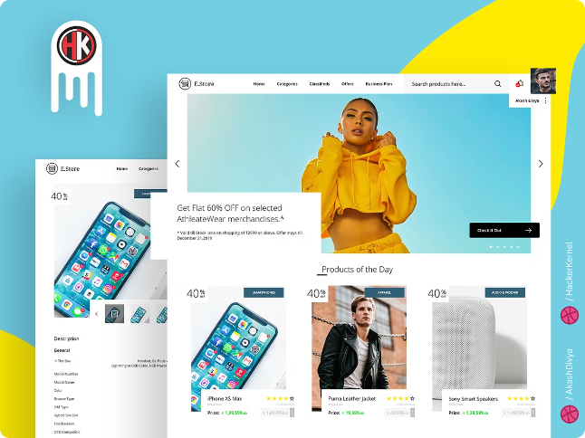
Designing a Captivating E-commerce Website
Crafting an engaging online store involves a multi-faceted approach that goes beyond aesthetics. It's about creating a seamless and intuitive experience for your customers.

Slide 2


Defining Your Brand and Target Audience
Brand Identity
Target Audience Analysis
Develop a unique brand voice and visual language. This should resonate with your target audience and communicate your core values.
Understanding your customer demographics, interests, and needs is crucial for tailoring your website and product offerings.
Competitive Research
Analyzing competitors helps identify successful strategies and understand market trends. This can inform your design choices.

Slide 3
Developing a Responsive and User-Friendly Layout
Navigation
Content Hierarchy
Responsive Design
Clear and intuitive navigation makes it easy for customers to find what they need. Consider using mega menus for large product catalogs.
Prioritize important information, such as product details and calls to action. Use visual cues, such as headings, subheadings, and images, to guide users.
Ensure your website adapts seamlessly to different screen sizes. A responsive design provides an optimal experience on desktops, tablets, and smartphones.

Slide 4


Optimizing Product Presentation and Descriptions
1
High-Quality Images
2
Detailed Descriptions
Use professional product photography that showcases your products in a flattering and informative way. Consider using 360-degree views or zoom options.
Write compelling descriptions that highlight key features and benefits. Use keywords that customers are likely to search for.
3
Customer Reviews and Ratings
4
Product Videos
Consider using product videos to demonstrate features and provide a more engaging experience.
Encourage customer reviews and ratings to build trust and provide social proof.

Slide 5


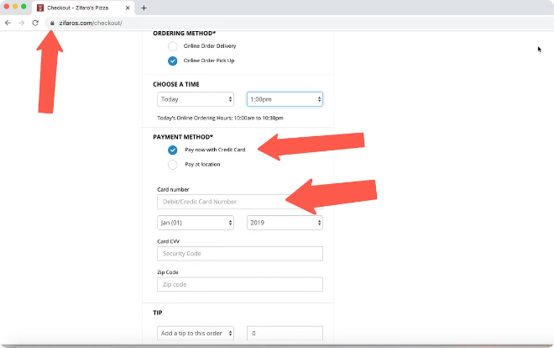


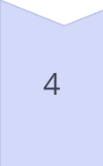
Implementing Secure and Efficient Checkout Process
Secure Payment Gateways
Use trusted and secure payment gateways to protect customer data.
Multiple Payment Options
Offer a variety of payment methods, including credit cards, debit cards, and digital wallets.
Clear Shipping Information
Provide transparent and accurate shipping information, including costs, delivery timeframes, and return policies.
Order Tracking
Offer real-time order tracking so customers can monitor the progress of their shipment.

Slide 6

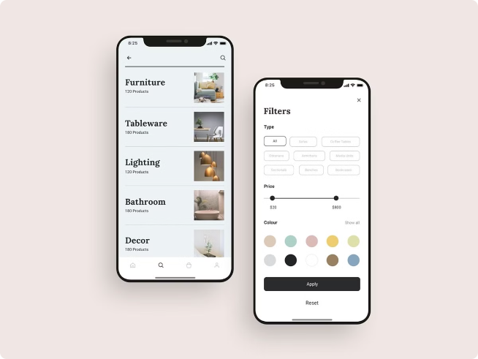
Incorporating Effective Search and Filtering Options
Search Functionality
Implement a powerful search engine that allows customers to find products quickly and easily.
Filtering Options
Provide a range of filtering options, such as price, size, color, and brand, to help customers narrow down their search.
Auto-Suggest
Use auto-suggest to provide search suggestions as customers type, improving the search experience.

Slide 7

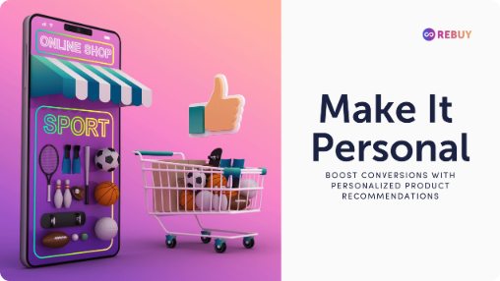



Leveraging Personalized Recommendations and Upselling
Product Recommendations
Upselling and Cross-selling
Personalized Offers
Use algorithms to recommend relevant products based on customer browsing history and purchase preferences.
Suggest complementary products or higher-priced alternatives to increase average order value.
Offer targeted promotions and discounts based on customer behavior and preferences.

Slide 8


Integrating Social Media and Customer Engagement
1
Social Media Integration
Allow customers to share products on social media platforms and offer social login options for easy account creation.
2
Customer Reviews and Feedback
Encourage customer feedback and reviews to build trust and improve the shopping experience.
3
Live Chat Support
Offer live chat support to provide instant assistance and answer customer questions.

Slide 9
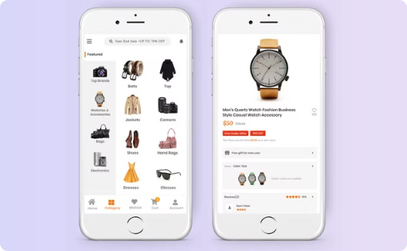
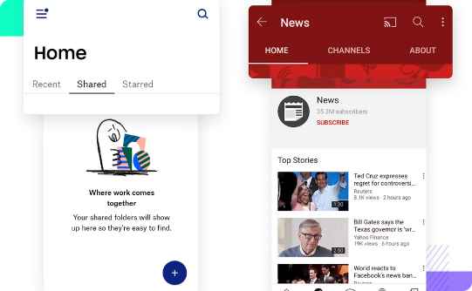
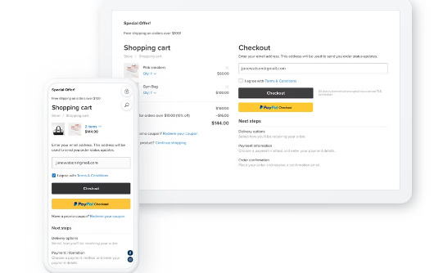
Ensuring Seamless Mobile Experience
Optimized for Mobile Devices
Intuitive Navigation
Simplified Checkout Process
Ensure your website loads quickly and renders properly on all mobile devices.
Design a mobile-friendly navigation menu that is easy to use on smaller screens.
Streamline the checkout process for mobile users to reduce friction and encourage conversions.

Slide 10

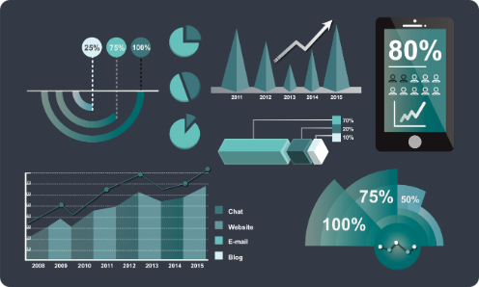
Analyzing Data and Optimizing for Continuous Improvement
1
Website Analytics
2
A/B Testing
3
Customer Feedback
Track website traffic, user behavior, and conversion rates to identify areas for improvement.
Experiment with different website elements to see what performs best. This can help optimize design and content.
Regularly solicit customer feedback to understand their needs and improve the overall shopping experience.

